Slide 1
Thinking about Graphs
The Grammar of Graphics and Stata

Slide 2
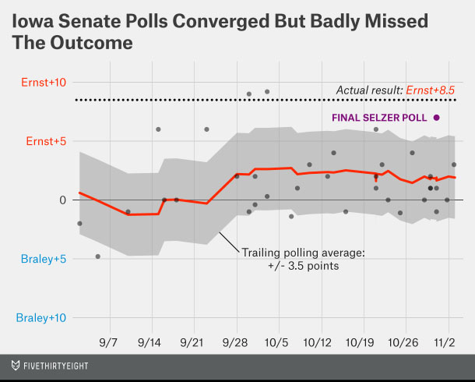
Reconstructing a graph
From
http://fivethirtyeight.com/features/heres-proof-some-pollsters-are-putting-a-thumb-on-the-scale/
Notes:
We are often asked to help someone reproduce a graph published somewhere, or produce a similar graph.

Slide 3
Questions toward reconstruction
What are the graphical elements?
How are they related to data?
How are they arranged on the screen/paper?
How are they decorated?
Notes:
Graphical elements: points, lines, shaded areas.
Relation: given in the data, or derived?
Screen layout: coordinates, scales.
Decoration: color, weight, pattern, annotation, etc.

Slide 4
Graphical elements
Points
Line(s)
Area
Notes:
This graph has all three!

Slide 5
Relation to data
Points: polling margins versus dates, essentially a scatter plot
Lines:
Grid lines, some emphasized
Trailing margin is polling averages versus dates, connected (a.k.a. a line plot)
Area: a fixed range around the trailing margin
Given the points, the lines and area can be calculated
Notes:
Points are essentially the observational data.
Lines are derived from the points.
Area is derived from the line.

Slide 6
Arrangement
Think in layers, points on top of lines on top of area
Notes:
The order of the layers matters.
Lining things up means finding common scales and coordinates.

Slide 7
Layered together
Notice the scales now match.
The scales/coordinates are critical to how the elements are aligned on the page, and with each other.
Notes:
At it’s heart, this is it.

Slide 8
Decoration/Aesthetics
Titles and footnotes
Color, weight, etc. of graphical elements
Axis and legend text
Grid or guidelines
Etc. – there tend to be a large number of options at this point
Notes:
No we fix aesthetics for clarity.

Slide 9
Reconstructed

Slide 10
Programming
The final program starts with the end result in mind
Get the data, convert data types and layout (long vs. wide) as necessary
Calculate data values needed
Specify the graphics

Slide 11
Get, clean, convert the data
import delimited "Iowa HuffingtonPost.csv", clear
generate LV = strpos(pop, "LV") > 0
keep if LV // Just use "likely voter" polls, not "registered voters"
// Convert data from string to a form useful for graphing
generate polldate = date(substr(date,strpos(date, "-")+2,.)+"/2014", "MDY")
format polldate %tdnn/dd
sort polldate // sorting will make a nicer line graph, eventually
rename margin spread
generate margin = ernst - braley

Slide 12
Calculate other needed data
generate trailing21 = .
forvalues i = 1/`=_N' {
local j = `i' - 1
generate win`i' = (polldate - polldate[`i']) >= -21 ///
& (polldate - polldate[`i']) <= 0
egen trailing21`i' = total(margin) if win`i'==1
egen pool`i' = total(win`i')
generate trailmargin`i' = trailing21`i'/pool`i'
replace trailing21 = trailmargin`i' in `i' if pool`i' >= 3
drop win`i' trailing21`i' pool`i' trailmargin`i'
}
generate trailing = trailing21[_n-1]
generate lmoe = trailing - 3.5
generate umoe = trailing + 3.5

Slide 13
Basic graphical specification
keep if polldate > td(1sep2014)
twoway rarea umoe lmoe polldate || ///
scatter margin polldate || ///
line trailing polldate

Slide 14
With decoration
label variable polldate "Poll ending date"
label variable margin "Polling margin"
label variable trailing "Trailing average"
label variable lmoe "-3.5%"
label variable umoe "+3.5%"
twoway rarea umoe lmoe polldate, color(gs12) || ///
scatter margin polldate, color(black) || ///
line trailing polldate, color(red) ///
yline(8.5, lpattern(dot)) yscale(range(-10(5)12)) ///
ylabel(-10 "+10% Braley" -5 "+5% Braley" 0 "0" 5 "+5% Ernst" 10 "+10% Ernst", angle(0)) ///
title("Iowa Senate Polls Converged") subtitle("(But Badly Missed the Outcome)") ///
note("data from Huffington Post, analysis after fivethirtyeight.com")

Slide 15
After all the steps

